Slide 1
Feature Detection and Matching
Chul Min Yeum
Assistant Professor
Civil and Environmental Engineering
University of Waterloo, Canada
CIVE 497 – CIVE 700: Smart Structure Technology
Last updated: 2019-02-27

Slide 2
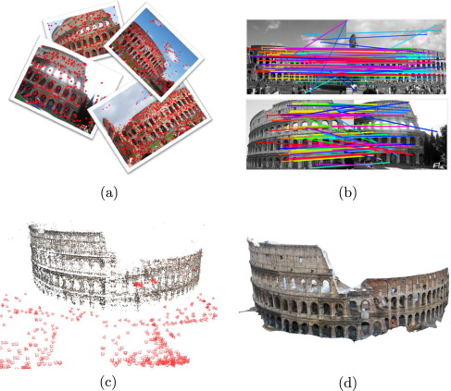

Two Major Challenge in Computer Vision
Image recognition
Feature matching

Slide 3


Why We Extract Features? Extracting Features
Motivation: panorama stitching
We have two images – how do we combine them?

Slide 4


Why We Extract Features? Extracting Features (Continue)
Motivation: panorama stitching
We have two images – how do we combine them?

Slide 5

Why We Extract Features? Extracting Features (Continue)
Motivation: panorama stitching
We have two images – how do we combine them?

Slide 6
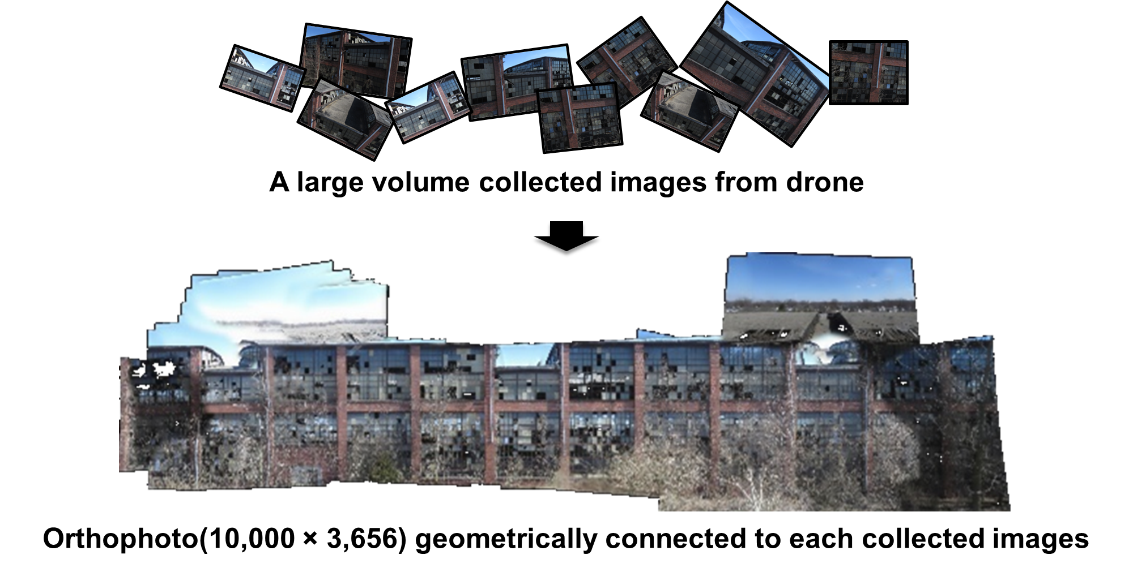
Example: Automatic Panoramas
Jongseong Choi, Chul Min Yeum, Shirley J. Dyke, and Mohammad R. Jahanshahi, “Computer-Aided Approach for Rapid Post-Event Visual Evaluation of a Building Façade,” Sensors, 18, 3017 (2018).

Slide 7
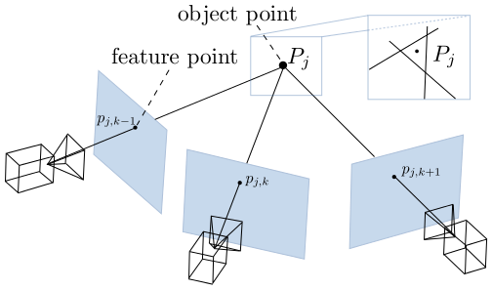
Example: Multiview Geometry

Slide 8


Image Matching

Slide 9
What are Features (Keypoints)?
A feature is an interesting point that is selected based on a certain criteria, such as edge, corner, or blob.
This is represented in terms of the coordinates of the image points by pixel or sub-pixel.
The feature likely contain and preserve the distinctive local regional information.
Note: “interest points” = “keypoints”, also sometimes called “features”
Many applications:
Object/motion tracking: which points are good to track?
Object recognition: find patches likely to tell us something about object category
3D scene reconstruction: find correspondences across different views
Notes:
https://stackoverflow.com/questions/27595455/what-is-a-feature-descriptor-in-image-processing-algorithm-or-description

Slide 10
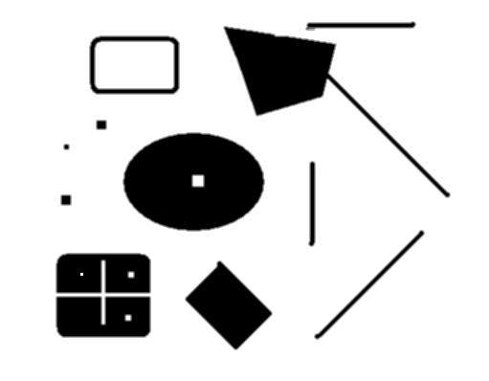
Example: Keypoints/Features
Suppose you have to click on some point, go away and come back after I deform the image, and click on the same points again. Which points would you choose?
deformed
original

Slide 11
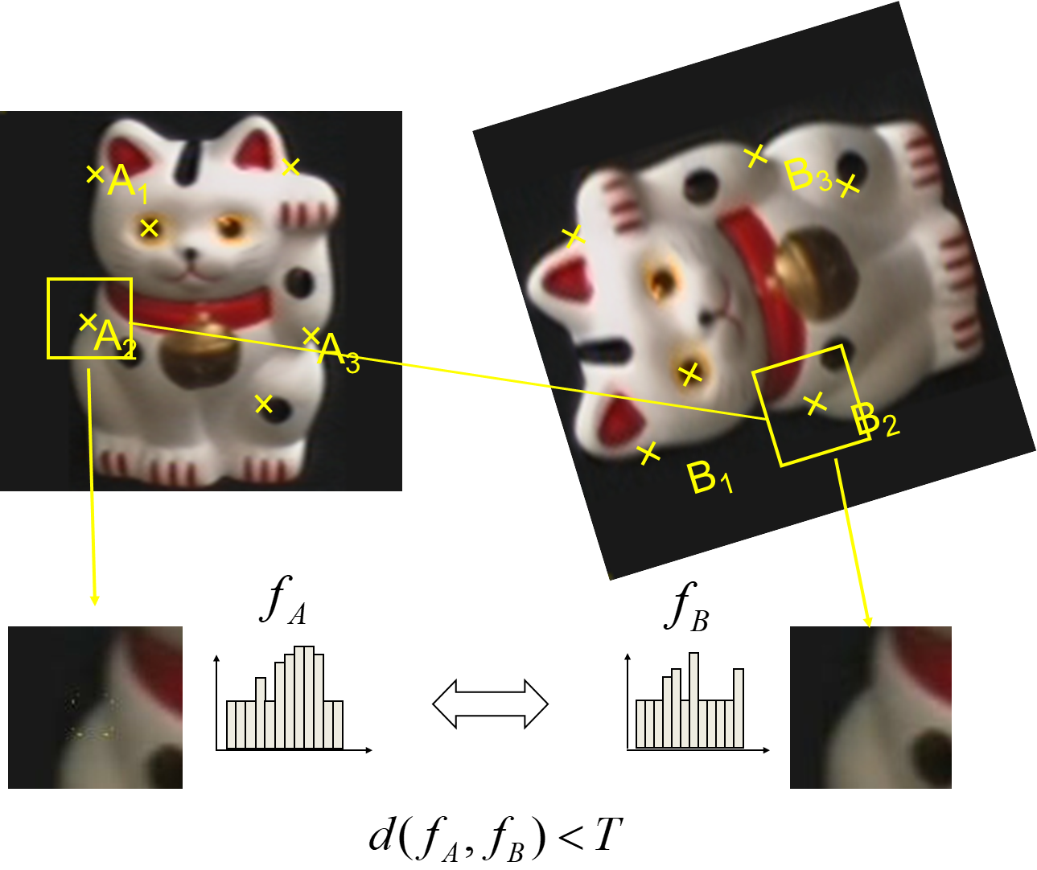
Overview of Feature Matching
Find a set of distinctive key-points
Define a region around each keypoint
Extract and normalize the region content
Compute a local descriptor from the normalized region
Match local descriptors

Slide 12


Goal for Features
Detect points that are repeatable and distinctive

Slide 13
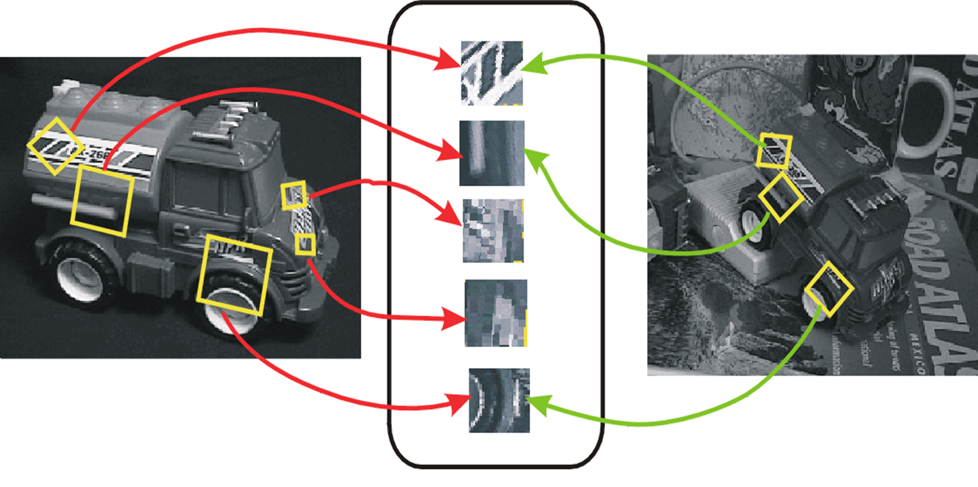
Invariant Local Features
Image content is transformed into local feature coordinates that are invariant to translation, rotation, scale, and other imaging parameters

Slide 14
Characteristic of Good Features
Repeatability: The same feature can be found in several images despite geometric and photometric transformations
Saliency: Each feature is distinctive
Compactness and efficiency: Many fewer features than image pixels
Locality: A feature occupies a relatively small area of the image; robust to clutter and occlusion

Slide 15
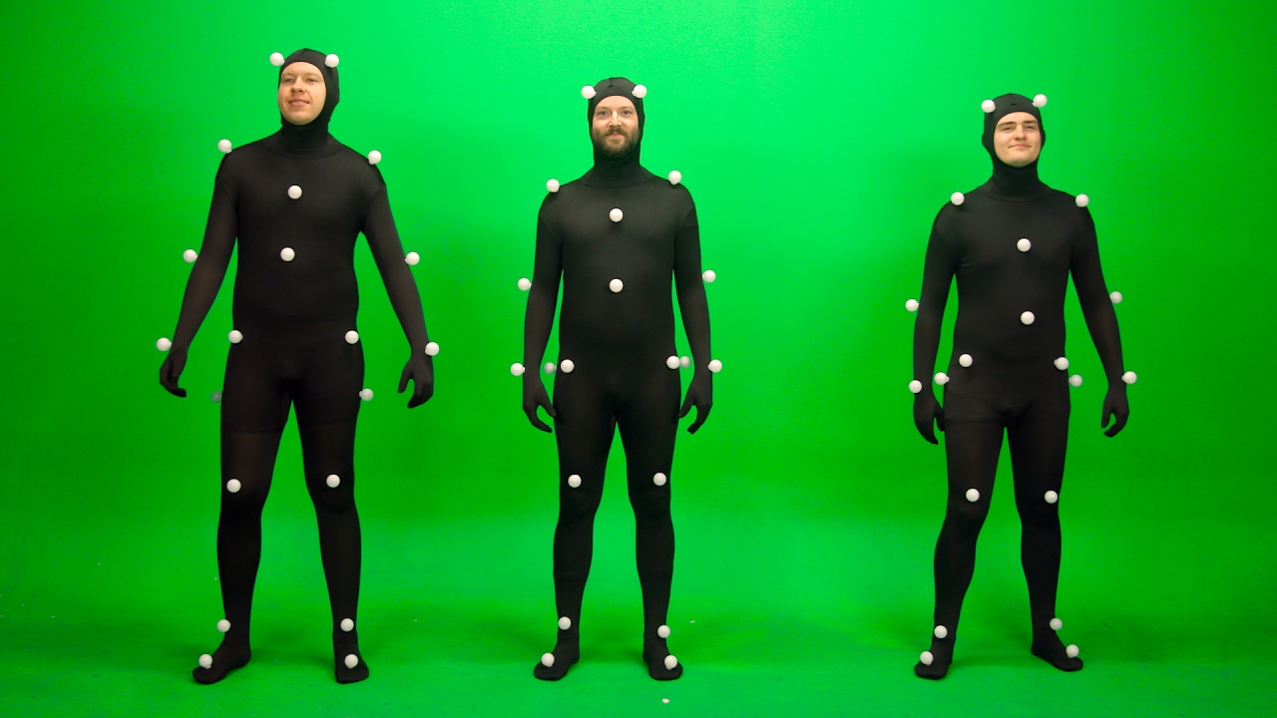
Example: Motion Capture

Slide 16
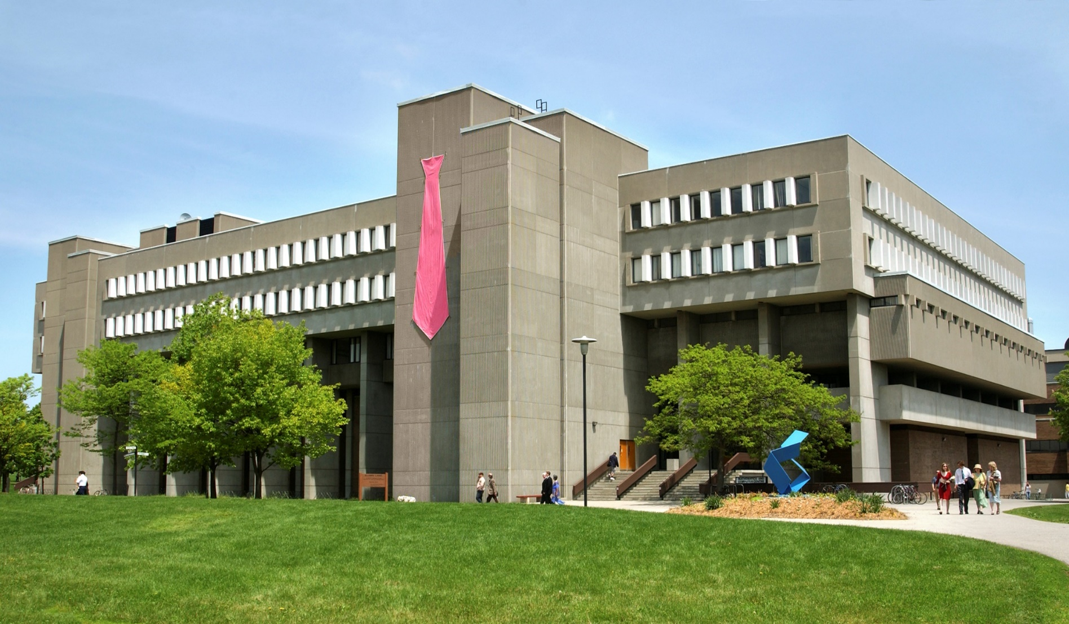
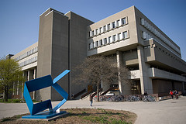
What Points would You Choose?

Slide 17

Corner Detection: Basic Idea
We should easily recognize the point by looking through a small window
Shifting a window in any direction should give a large change in intensity
Flat region
no change in all directions
Edge no change along the edge direction
Corner significant change in all directions

Slide 18
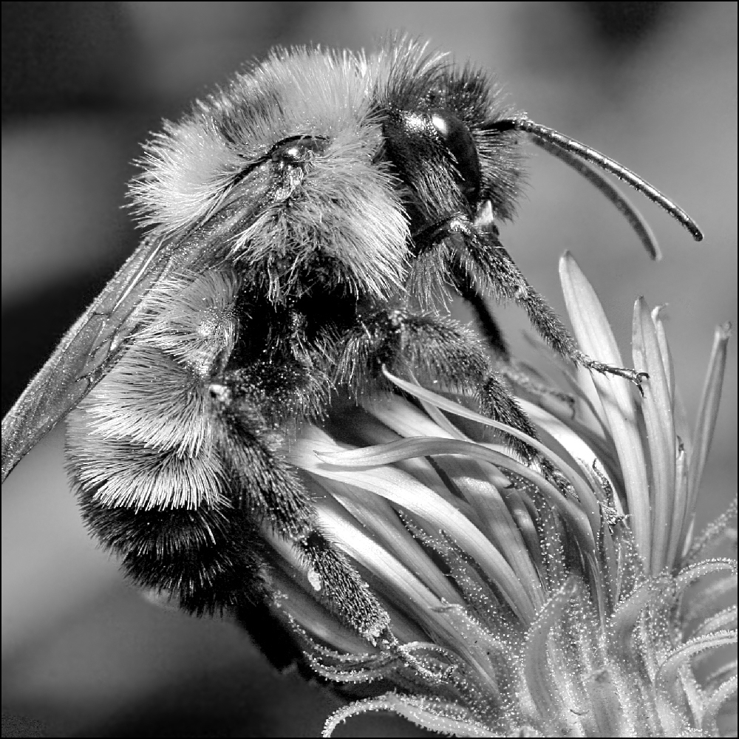
Image Transformations
Geometric
Rotation
Scale
Photometric
Intensity change

Slide 19
Invariance and Covariance
We want corner locations to be invariant to photometric transformations and covariant to geometric transformations
Invariance: image is transformed and corner locations do not change
Covariance: if we have two transformed versions of the same image, features should be detected in corresponding locations

Slide 20
Intensity Change
I → a I + b
Only derivatives are used => invariance to intensity shift I → I + b
Intensity scaling: I → a I
R
R
threshold
x (image coordinate)
x (image coordinate)
Partially invariant to affine intensity change
Source: James Hayes

Slide 21
Image Translation
Derivatives and window function are shift-invariant
Corner location is invariant to image translation

Slide 22
Image Rotation
Second moment ellipse rotates but its shape (i.e. eigenvalues) remains the same
Corner location is invariant to image rotation

Slide 23
Scaling
Corner
All points will be classified as edges
Corner location is not invariant to image scale!

Slide 24
Scale Invariant Detection
Consider regions (e.g. circles) of different sizes around a point
Regions of corresponding sizes will look the same in both images

Slide 25
Scale Invariant Detection (Continue)
The problem: how do we choose corresponding circles independently in each image?
Choose the scale of the “best” corner

Slide 26


Example: Scale Invariance
Notes:
https://unsplash.com/photos/anV_zgNDZhc

Slide 27
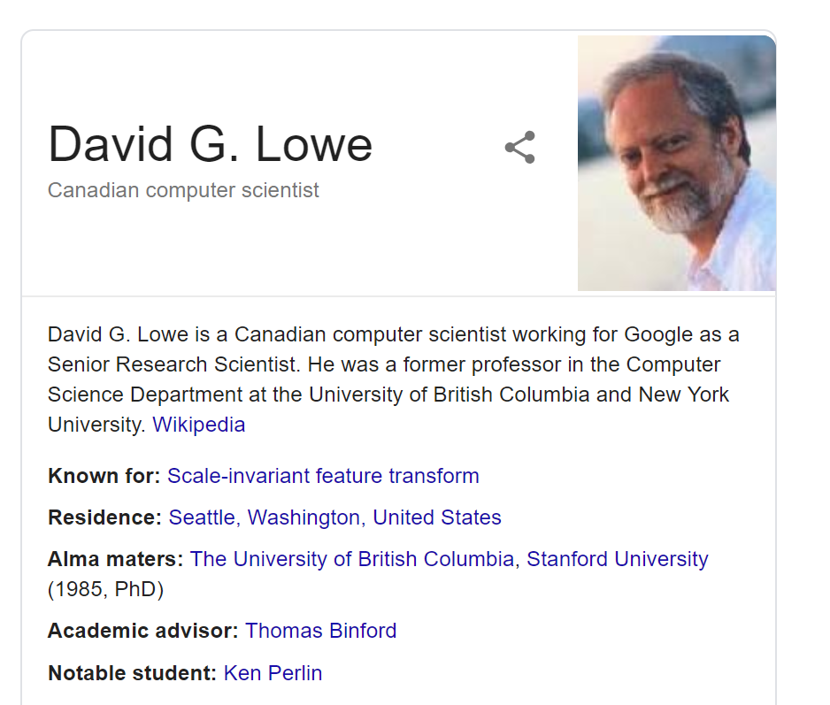
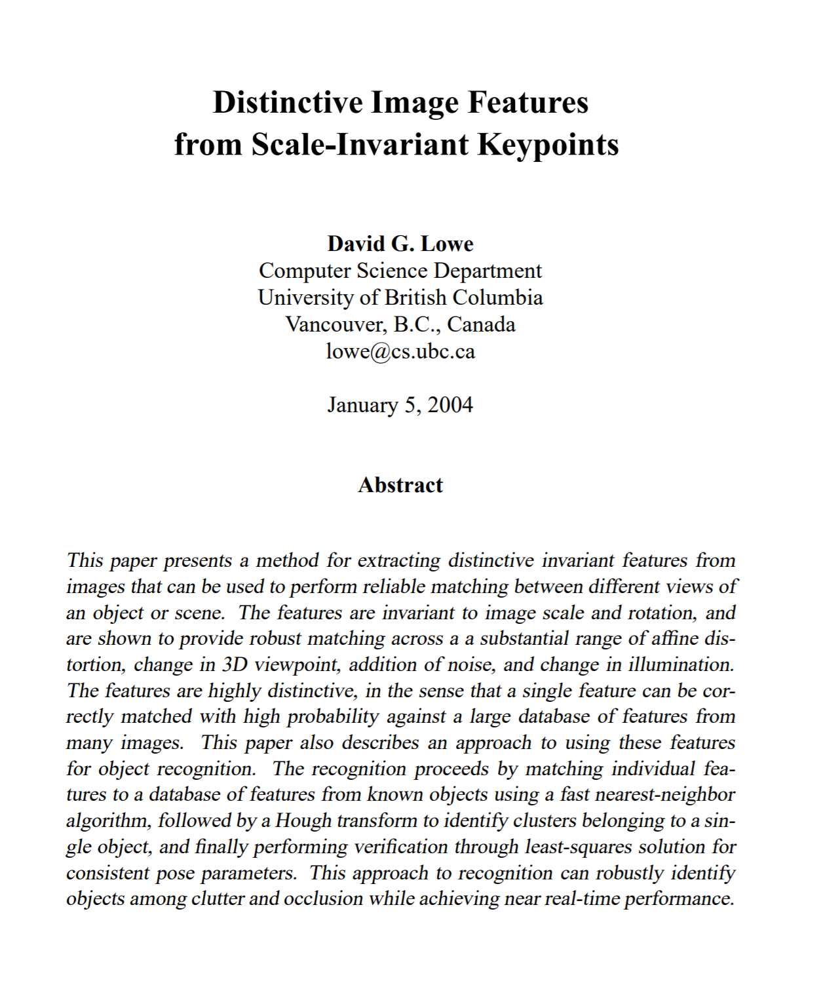
SIFT: Scale-Invariant Feature Transform

Slide 28
Steps for Extracting SIFT Keypoints
Scale-space extrema detection: Difference-of-Gaussian function is used to identify potential interest points that are invariant to scale and orientation.
Keypoint localization: At each candidate location, a detailed model is fit to determine location and scale. Keypoints are selected based on measures of their stability.
Orientation assignment: One or more orientations are assigned to each keypoint location based on local image gradient directions. All future operations are performed on image data that has been transformed relative to the assigned orientation, scale, and location for each feature, thereby providing invariance to these transformations.
Keypoint descriptor: The local image gradients are measured at the selected scale in the region around each keypoint. These are transformed into a representation that allows for significant levels of local shape distortion and change in illumination.

Slide 29
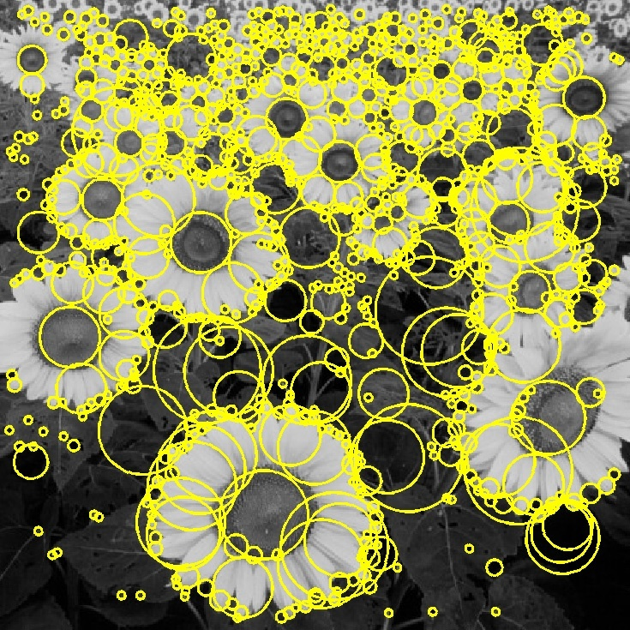

Basic Idea
Convolve the image with a “blob filter” at multiple scales and look for extrema of filter response in the resulting scale space

Slide 30
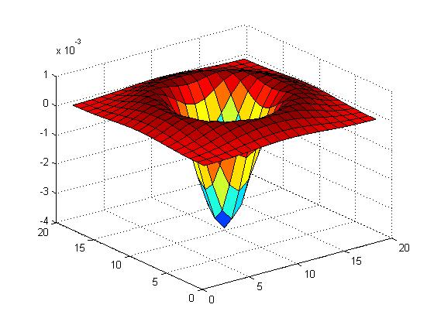
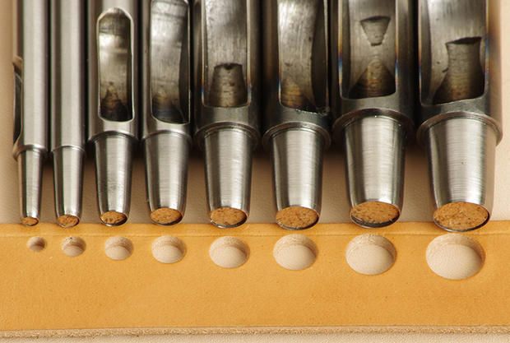
Blob Filter
Laplacian of Gaussian: Circularly symmetric operator for blob detection in 2D

Slide 31
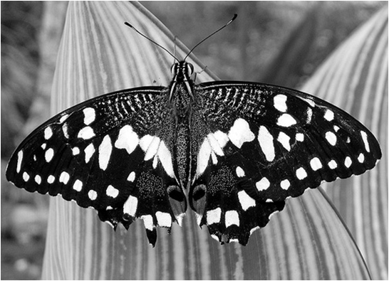
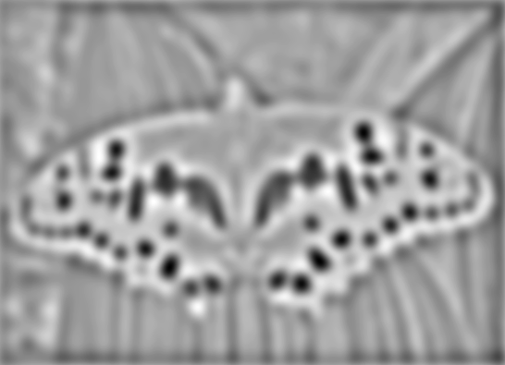

Blob Detection
Find maxima and minima of blob filter response in space and scale
minima
*
=
maxima

Slide 32
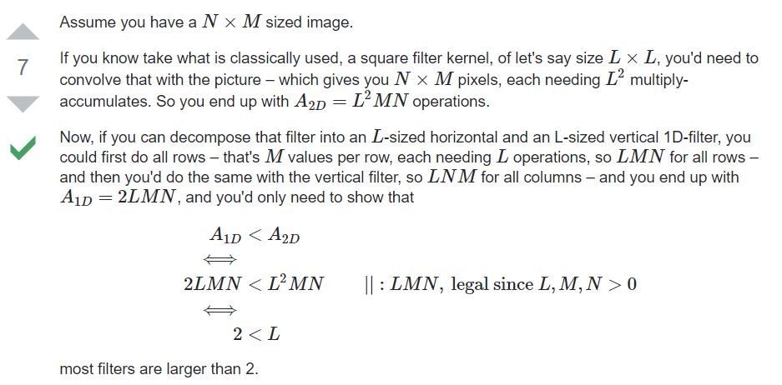
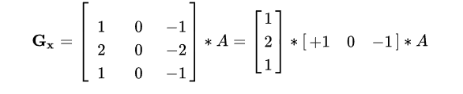
Separable Filter
https://dsp.stackexchange.com/questions/36962/why-does-the-separable-filter-reduce-the-cost-of-computing-the-operator

Slide 33
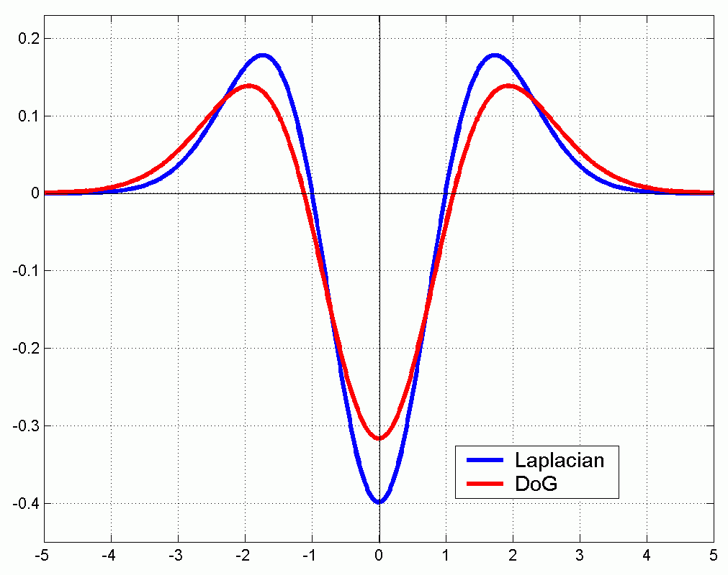
Efficient Implementation
(Laplacian)
(Difference of Gaussians)

Slide 34

Octave
$$σ$$
increase
f/2
f

Slide 35
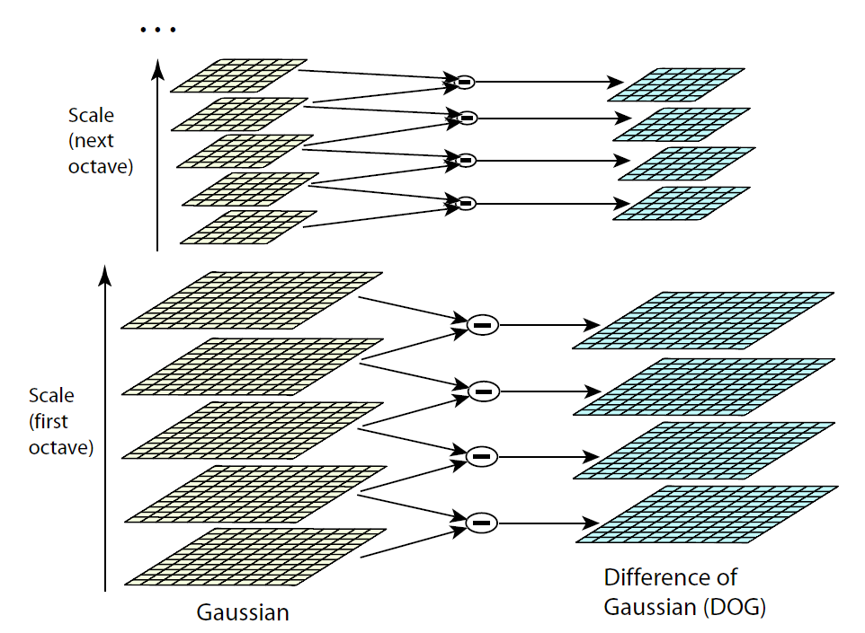


Gaussian Scale Pyramid
Sampling with step σ⁴ =2
σ
σ
σ
Original image
σ

Slide 36
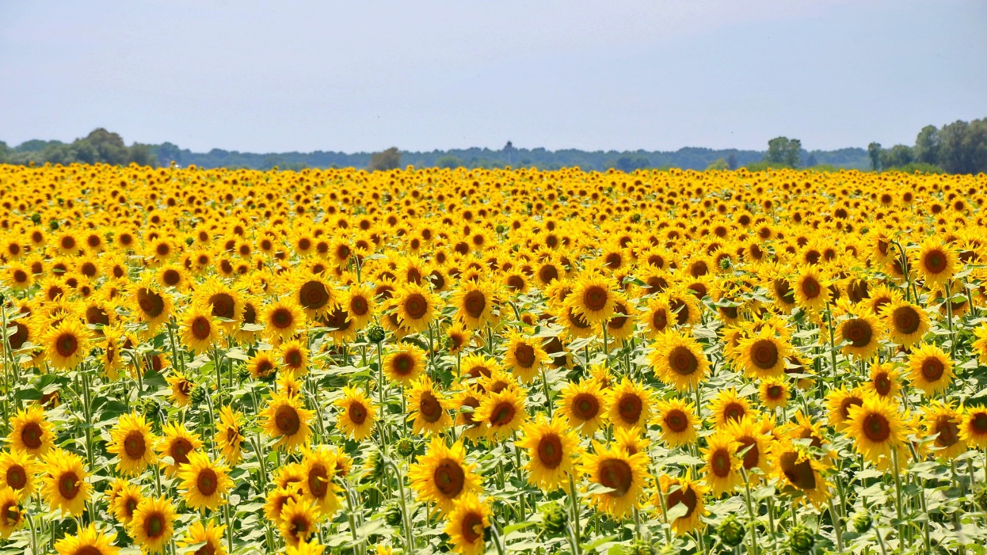
Example: Sunflower

Slide 37
Gaussian Smoothing

Slide 38
Difference of Gaussian
Sigma0*1.270
Sigma0*1.6
Sigma0*2.0
Sigma0*2.5

Slide 39
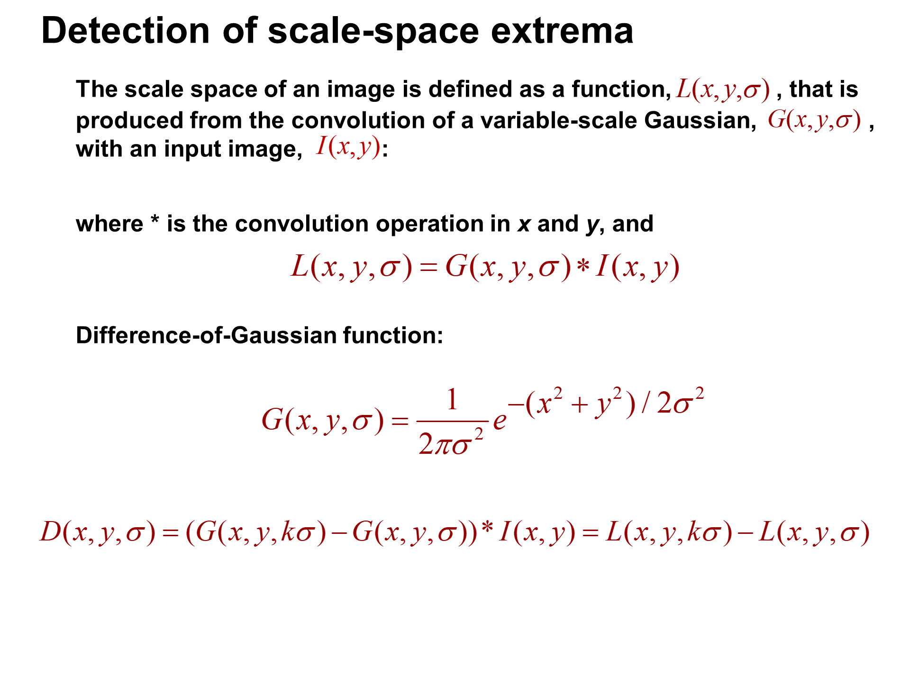
Keypoint Detection

Slide 40
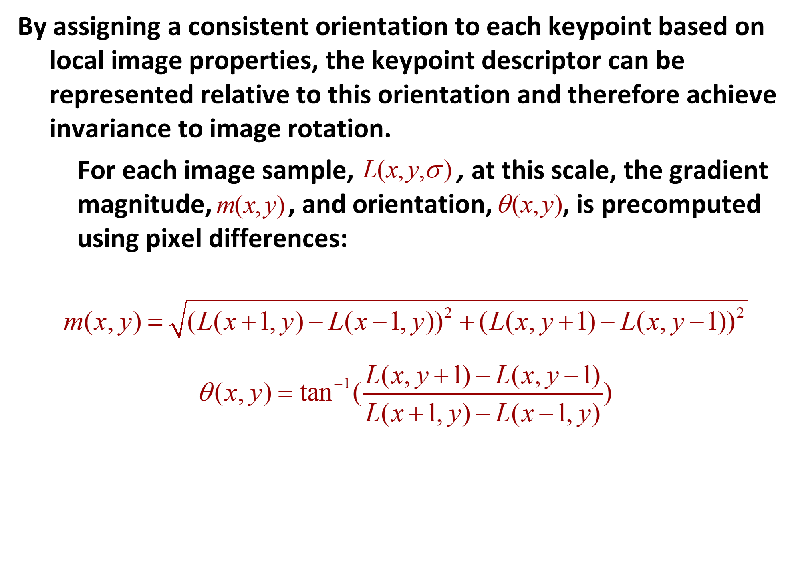
Orientation Assignment

Slide 41
Orientation Normalization
Compute orientation histogram
Select dominant orientation
Normalize: rotate to fixed orientation
0
2
π

Slide 42

Eliminating Rotation Ambiguity
To assign a unique orientation to circular image windows:
Create histogram of local gradient directions in the patch
Assign canonical orientation at peak of smoothed histogram
0
2
π

Slide 43

Example: Orientation

Slide 44
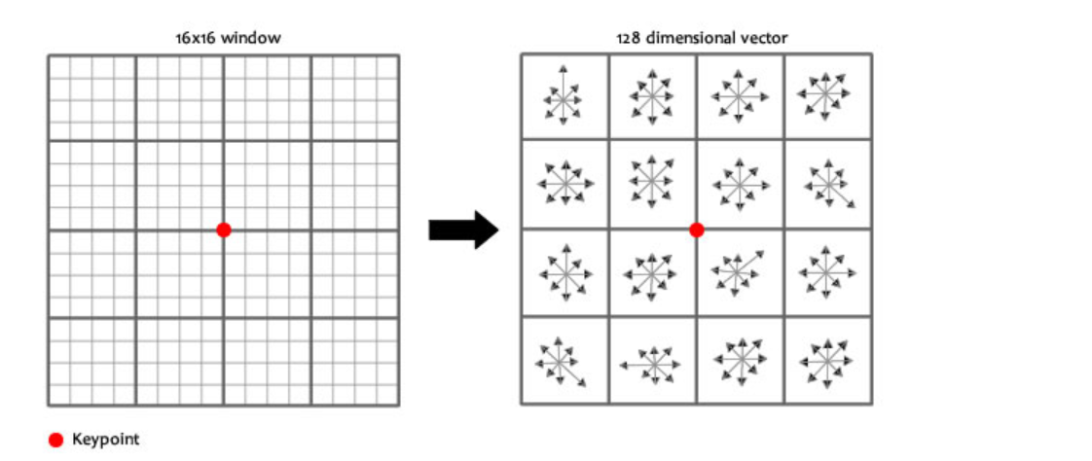
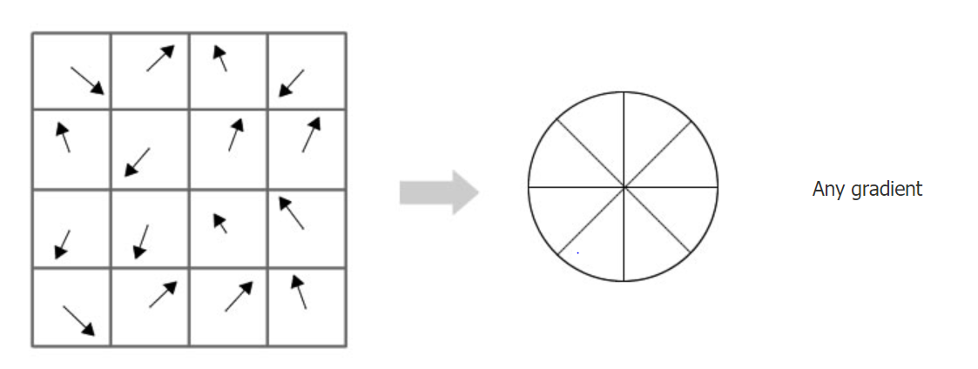
SIFT Descriptor

Slide 45
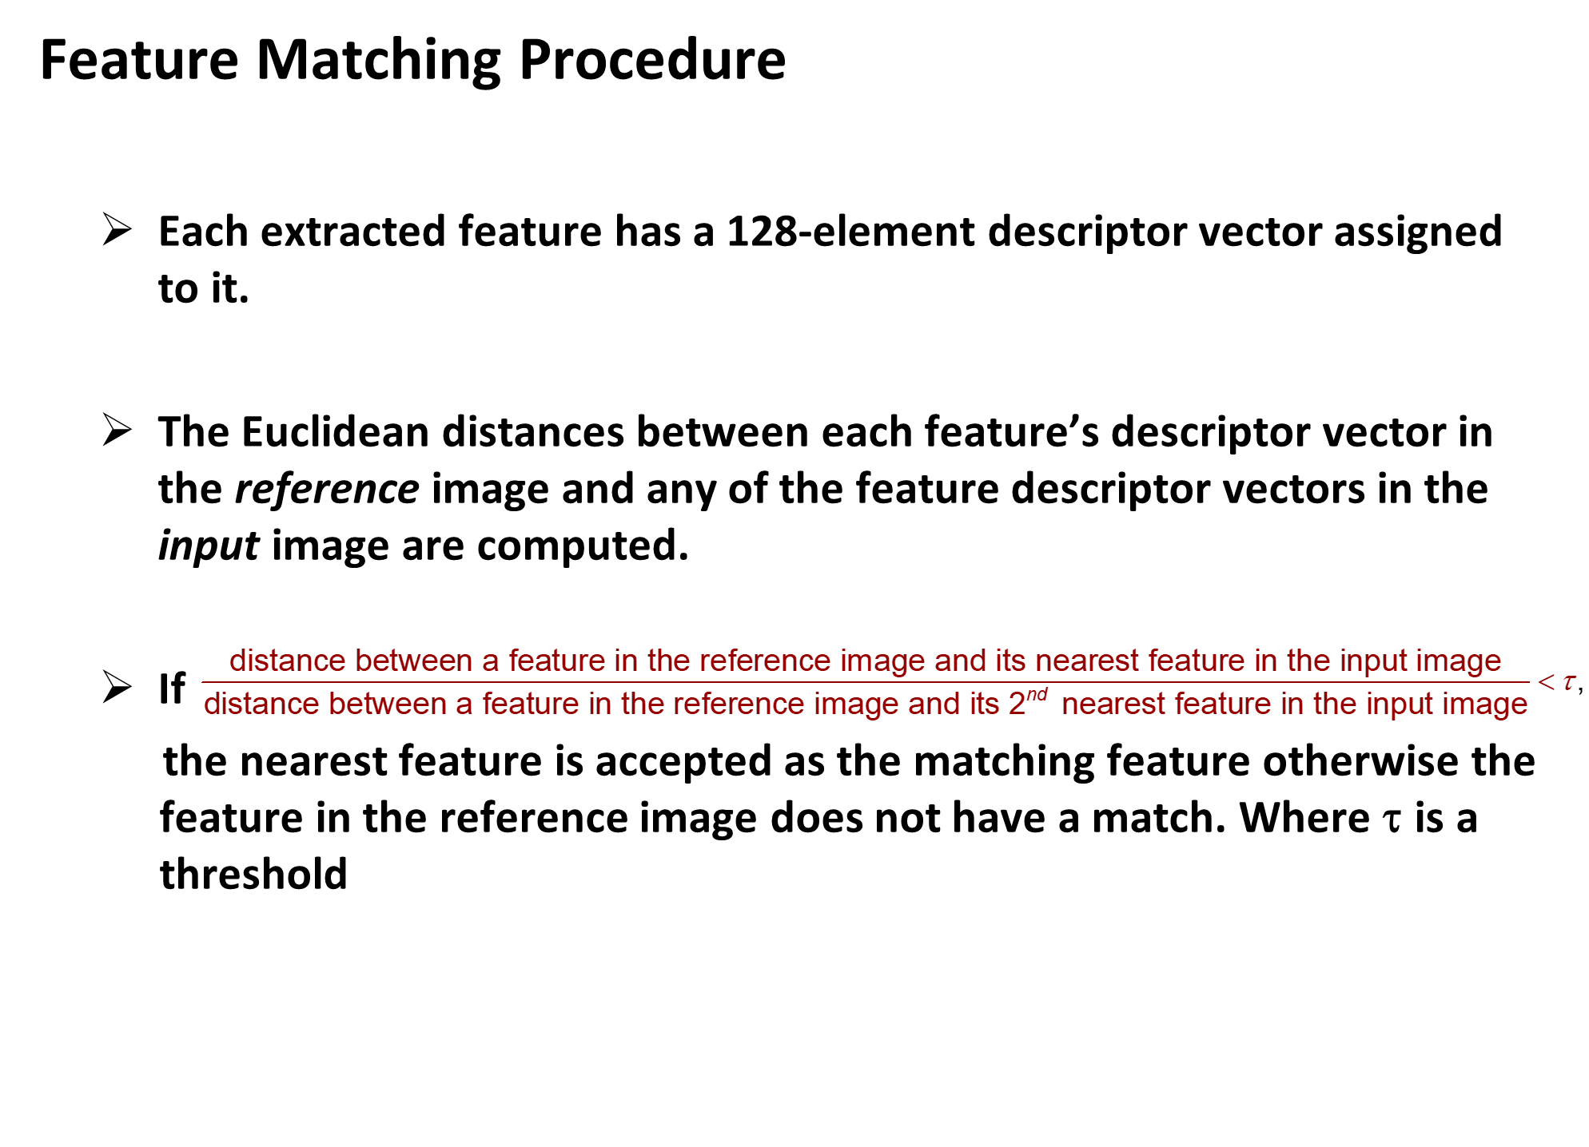
Keypoint Matching

Slide 46
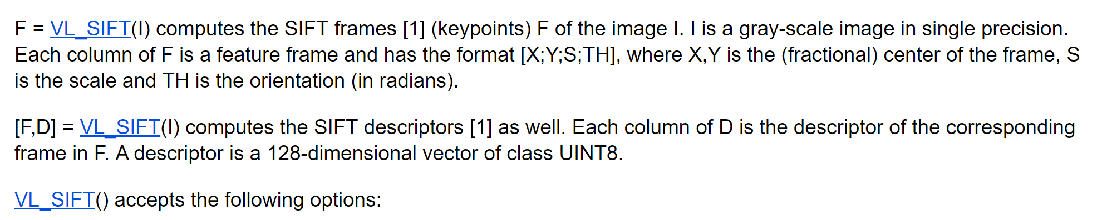
SIFT Library
http://www.vlfeat.org/overview/sift.html

Slide 47
Slide Credits and References
Lecture notes: S. Narasimhan
Lecture notes: Gordon Wetzstein
Lecture notes: Mohammad Jahanshahi
Lecture notes: Noah Snavely
Lecture notes: L. Fei-Fei
Lecture notes: D. Frosyth
Lecture notes: James Hayes
Lecture notes: Yacov Hel-Or
Lecture notes: K. Grauman, B. Leibe

